Slide 1
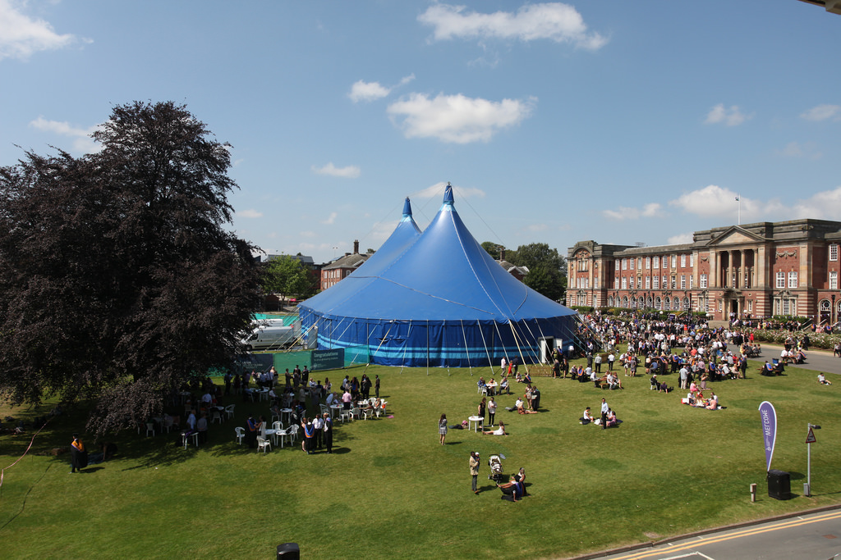
Final Year Project
Week 3 Research & Development Methods
Dr. Mark Dixon (Module Leader)
Caedmon 118
With contribution
from Pip Trevorrow

Slide 2
Overview
A large proportion of work involved in the project is research
You will have to do initial research to help you justify and plan the project
You will then continue to research in order to support product development and personal knowledge
The final report includes a significant amount of content based on your research activities
Notes:
2

Slide 3
The Meaning of Research
“Research” can mean two things:
Discovering “new knowledge” – knowledge previously unknown to anyone
- As required in a PhD, for example
- Researching into a cure for cancer
Discovering “existing knowledge” – knowledge previously unknown to you, but known to others
- “Discovery learning” at school
- Researching software capabilities
- Researching HCI guidelines

Slide 4
L6 Project Research
For the L6 Project, discovering “existing knowledge” is generally what your are aiming for.
However, if your project does involve discovering “new knowledge”, then this would be more than welcome.
Many product driven projects are focussed on delivering a product for end-users rather than helping discover new knowledge, but not always.
You may want to consider a research degree at some stage, e.g. M.Res, M.Phil, Ph.D.
Notes:
4

Slide 5
Types of Research
Primary
Often empirical investigation
Some sort of field work, e.g. experiments, questionnaires, interviews.
Secondary
Literature review
Required for discovering both “new” and “existing” knowledge
For the L6 project you must all do the latter, and some projects will also require the former.
Notes:
5

Slide 6
Secondary Sources
There are various broad categories of literature (some better than others).
General sources
magazines, web-sites, blogs
contain useful information for gaining knowledge
often based on opinion rather than fact
Text Books
Good for self-study, includes user manuals etc.
Also based on opinion, but often good quality
Journals/Refereed Conference papers
Often based on fact due to rigorous review process
High quality sources when making academic arguments
Notes:
6

Slide 7
Project Requirements
A good project should involve research throughout
Academic type research
Use this to identify theoretical underpinnings of the area
Try to analyse and critique available information
Often a lit. review of high quality sources, i.e. journals
e.g. compare and contrast network vs relational storage mechanisms for Database systems.
Technology type research
Use this to help you learn about required technologies
More likely to use books, manuals etc. than journals.
e.g. learn about a programming language for web-development, learn syntax for implementing DB indexes, identify best way to use UML for design.
Final report should have at least one chapter for each of these. Some “blurring” may occur!
Notes:
7

Slide 8
Points to consider
What is it you want to research?
Why do you think it is important?
Does it relate to the purpose of the project?
How do you propose to go about investigating the available information?
Why do you see this as a good approach?
Can you justify your project and product by basing them on the literature?

Slide 9
Things to Avoid
Plagiarism! – Very important to avoid this.
From skills for learning:
Plagiarism is the term used for passing off other people's work as your own. This includes material or ideas from any source, whether printed, electronic, web-based or audio-visual.
Plagiarism includes:
Using extracts from a book or article without quotation marks
Paraphrasing a section of a website without acknowledgement

Slide 10
Plagiarism
Plagiarism is regarded as serious misconduct.
Written assignments, such as the Final Project Report are submitted and analysed using plagiarism detection software
See skills for learning
http://skillsforlearning.leedsbeckett.ac.uk/local/academic_communication/plagiarism
Includes “the little book of cheating, plagiarism and unfair practice” and “plagiarism quizzes”

Slide 11
Methodologies
Required within any good project
But what does it actually mean?
Terminology is sometimes confusing and mixed up-
Methodology
Development Methods (product development)
Research Methods
Project management Methods

Slide 12
Methodology
A term which refers to the concept of systematically describing or understanding methods within a particular field of study.
Often (incorrectly) used rather than the term method.
A methodology refers to the study of methods, not the methods themselves.
Try to focus more on the idea of the appropriate ‘method’ for your particular project

Slide 13
Development Methods
There are specific development methods (NOT methodologies) which are appropriate to production of software artefacts
Each method often involves a specific process model, tools and techniques.
The best method to use is not always obvious, and sometimes one method may be no better than another.
As part of the project you will have to select, justify and apply a development method.

Slide 14
Why use a method?
Without a method there is little control of a project or product development cycle.
Teamwork is almost impossible without some idea of what method is being applied.
Methods encourage you to be more professional and apply appropriate techniques and phases.
The BCS is very keen our projects contain evidence of method selection and application!

Slide 15
Typical SD methods
Waterfall
Specific stages following typical SDLC, rather rigid.
Prototyping
Good for establishing requirements, hard to measure progress
Spiral
Iterative approach involving prototyping each iteration
Agile
Popular approach with programmers, involves specific techniques (e.g. TDD) with minimal documentation and iterative (time-box based) development.
+ others, + specific examples (SSADM, DSDM, XP, Scrum etc.)

Slide 16
My Personal View
From my experience –
Agile usually works best for small teams (or one person)
Focus more on specific techniques within the methods, e.g. do some design with UML, do some automated testing, document the code directly with doxygen/javadoc
Use iterative design to help, not just because you are told to! ERDs, Class Models etc. are actually useful
Prototyping tends to work well with GUI driven problems

Slide 17
Other product types
From a research methods point of view most of you will be doing what is called “artefact production”
Not all projects will involve producing a software product
Consider alternative methods in this case.
Depending on the nature of your product, general research methods may be more appropriate
Consider a mixed method involving techniques such as
Experimentation, simulations, case studies, document review etc.
And don’t’ forget about the classic Scientific Method

Slide 18
Beware the fetish of methodology
‘Methodology [can become] a fetish, a procedure used with pathological rigidity for its own sake, not as a means to an end.’
Wastell, D. (1996) ‘The Fetish of Technique: Method as Social Defence’ Information Systems Journal, 6, pp. 25-40.
In other words
don’t forget about the project and the product you are developing and get too obsessed with the development process itself.
Do what is helpful and necessary and no more!

Slide 19
Summary
The project requires a lot of research –
academic type research, to support theory
technical type research, to support practice
Evidence of method application also required
Use SD method if developing S/W
Use other research method/techniques if not
You will all be applying PM techniques.

